Slide 1

Self healing grid
By
G Gowtham ee16btech11010
P Pavan ee16btech11030
P Vivek Vardhan ee16btech11025
G Preetham Reddy ee16btech11007

Slide 2
Introduction To Grids
Delivering electrical power from the generating station to consumption loads is the classical task for the power grid. However, a power grid and any other network’s infrastructure share some difficulties in operation, control, efficiency, and reliability mainly:
Numerous interconnected distributed components.
Any component/operation failure can easily affect other components/operations instantaneously.
Several interconnections and dependencies between the network variables. Thus, network mathematical modelling is a difficult challenge.

Slide 3
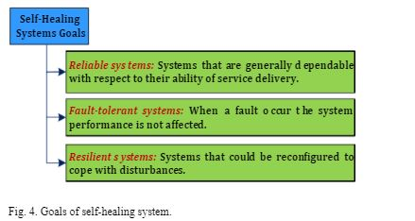
What is Self Healing Grid?
The Self Healing Grid is a system comprised of sensors, automated controls, and advanced software that utilizes real-time distribution data to detect and isolate faults and to reconfigure the distribution network to minimize the customers impacted.

Slide 4
Why Self Healing Grid
It is expected that the consumption rate of electricity will be twice the overall consumption rate of all other energy resources next decade .
Thus, using the electric power efficiently and reliably are crucial.
This raises the need of autonomous power grid operation by deploying hardware and software all over the power grid. Hence, the grid response to disturbances and malfunctions can be improved while obtaining efficient electrical power operation . Doing so, the smart grid (SG) is obtained.
In peak times,to avoid loss of infrastructure leading to blackouts.
Blaclouts lead to critical infrastructure failure such as telecommunication networks, financial services, water supplies and hospitals.

Slide 5
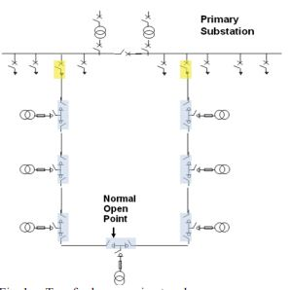
History of Self Healing Grid
The self-healing algorithm was originally designed for the very common scenario of two feeders connected in an open ring arrangement.
As shown in the Figure, often the two feeders are supplied from the same primary substation.The algorithm works
equally if the two feeders are supplied from
different primary substations.

Slide 6
Functions and Applications of Self Healing Grid
Self-healing function is the ability of a system to distinguish automatically between operating properly or not, then it can apply the required settings in order to retain its normal case of operation. Thus, the desired goals of self-healing systems can be summarized as
Fast and proper detection of grid disturbances.
Redistribution of grid resources to avoid adversative impacts.
Assuring the continuity of service under any conditions.
Minimization of service restoration time.
In power surges, power can be only given to hospitals and street lights to avoid generator damage.

Slide 7
Operational Principles:
1.Normal open point location:In order for the fault location algorithm to work, each controller in the system needs to know where it is relative to the normal open point.
When the SHG receives a “Topology Validation” command from the operator, each controller checks the status open/closed position of its own load break switches and responds with information on the number of open points.If the number of open points is valid, then a “topology valid” status signal is sent back.If there are no other inhibit conditions the operator can then proceed to switch on the system.
2.Fault Location Isolation and Restoration:The objective is to identify the section with a cable fault so that the system will open a switch in the substations at either end of the section.

Slide 8
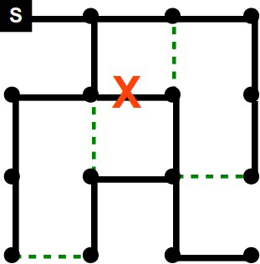
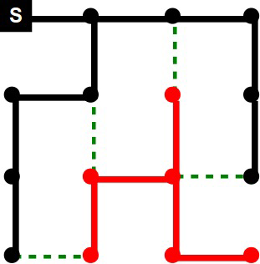
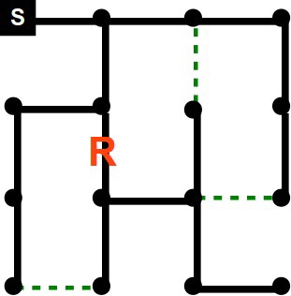
Self healing grid with one substation
Initial configuration 2) link failure 3) Recovered network

Slide 9
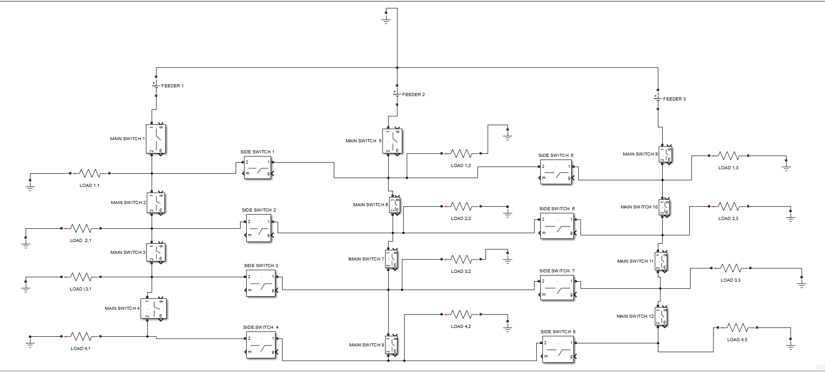
Network distrubution with 3 feeders
OUR PROJECT

Slide 10
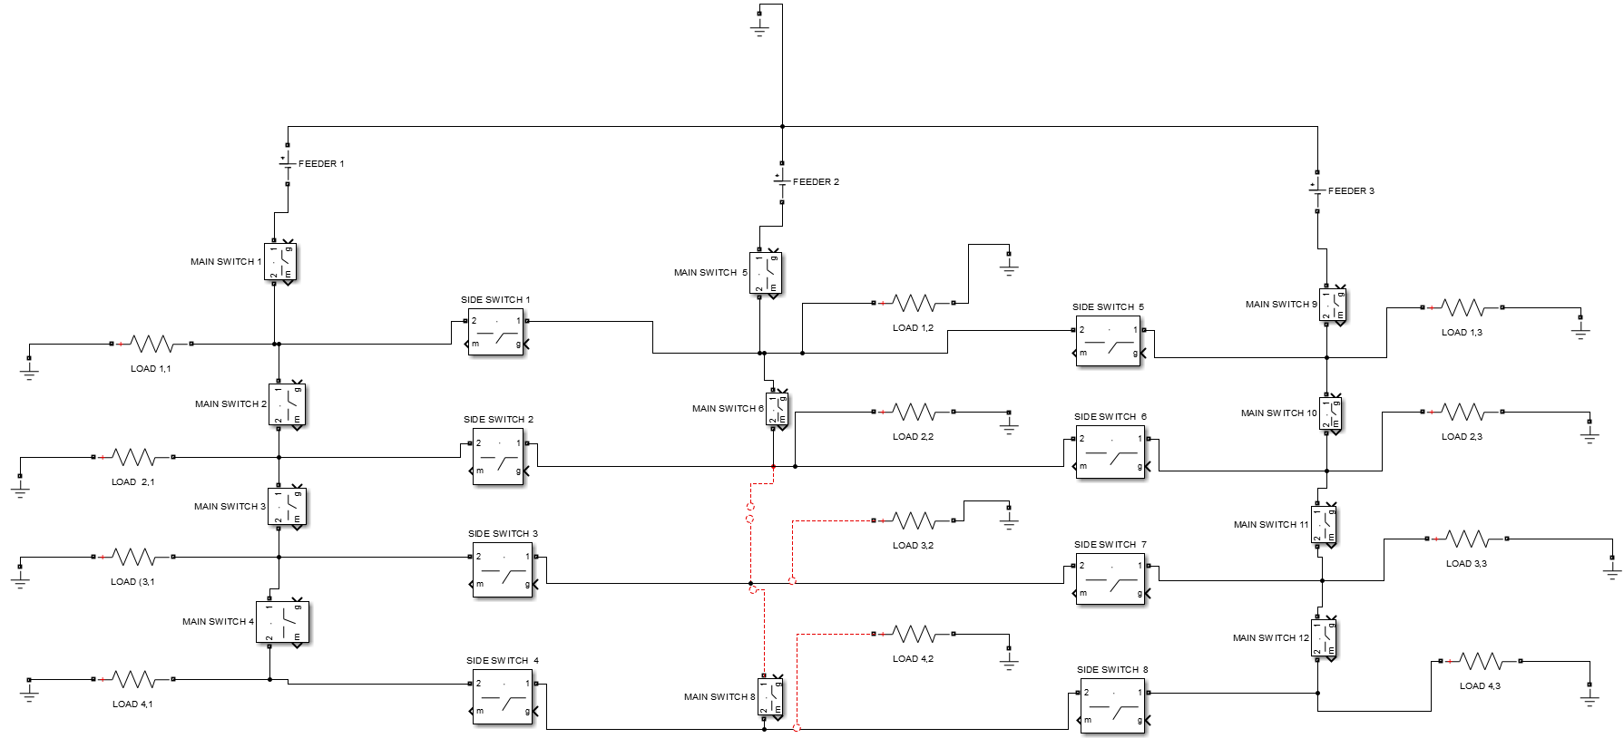

Slide 11
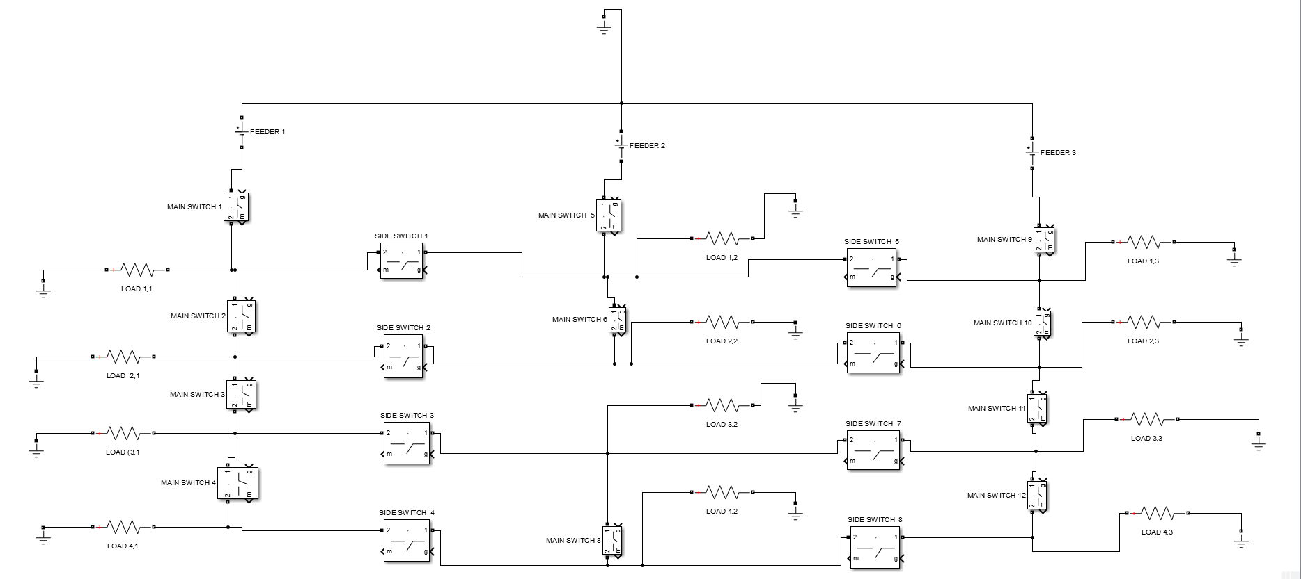

Slide 12
The power will be restored to the loads(LOAD 3,2 ,LOAD 4,2 ) by closing a side switch between the feeders
The switch through which we are feeding the load from the other substation should follow some conditions:-
Max current limit in a bus.
Total power of the loads should be less than substation supply.
Current shouldn’t flow reverse in a bus.
There should not be any closed loops in the network.

Slide 13
Calculation of power distribution
function logic3=supply(current1,logic,a,b,i,j)
x=size(logic,1);
logic3=zeros(x,1);
for t=1:x
if logic (t,1)==0&&logic(t,2)==0
logic3(t,1:end)=0;
elseif logic(t,1)==1 &&logic(t,2)==0
logic3(t,1:end)=1;
elseif logic(t,1)==0&&logic(t,2)==1
logic3(t,1:end)=2;
elseif logic(t,1)==1&&logic(t,2)==1
logic3=[logic3,logic3];
y=size(logic3,2);
logic3(t,1:y/2)=1;
logic3(t,(y/2)+1:end)=2;
end
end
logic4=logic3;
z=size(logic3,2);
for t=1:z
c=a;
d=b;
for s=1:x
if logic3(s,t)==1 && c>=current1(s+i-1,j)
c=c-current1(s+i-1,j);
elseif logic3(s,t)==2 && d>=current1(s+i-1,j)
d=d-current1(s+i-1,j);
logic3(s,t)=1;
else
logic3(s,t)=0;
end
end
end
for t=1:z
b=sum(logic3,1);
end
[~,I]=max(b);
for t=1:x
if logic3(t,I)==0
logic4(t,I)=0;
end
end
logic3=logic4(1:end,I);
end

Slide 14
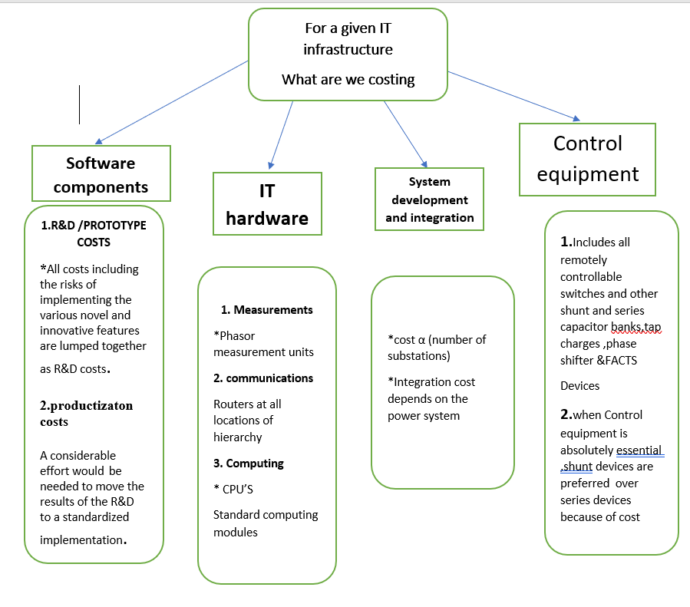
COST MODEL ANALYSIS

Slide 15
FINANCIAL FEASIBILITY
Challenges
Framework is broad
Includes all time scales milliseconds to hour
Too many cost factors -R&D ,SW, devices
Too narrow - not of interest
FEATURES
Reliability:- Fault detection and self-healing network.
Efficiency:-Trade off between marginal cost and cost to equip with the technology.
Load Adjustment:- Sudden increase in loads are managed by it, by warning large costumers to reduce the load.

Slide 16
Working of code for 3 feeder distribution system
Command:- [mainswitches, sideswitches]=powerdis(V0,check) in Matlab command window.
Where V0 is supply voltage and check is the fault location in the grid linearly indexed vertically.(Eg: The location (3,2) is indexed 8 and (2,3) as 10).
The load is randomly initialized in the code with values from 1 to 4,and maximum current is set to be 150A.
Output: Initially it prints the load and the current in each bus. Then it prints the final states of switches present in the circuit.
And the final current in each of the buses.
Even though the final current in a bus is open, it doesn’t mean the load connected to that bus is not being supplied power.

Slide 17
THANK YOU!!

